Slide 1
Chapter 7
Introduction to Structured Query Language (SQL)

Slide 2
Learning Objectives
In this chapter, you will learn:
  The basic commands and functions of SQL
  How to use SQL for data administration (to create tables and indexes)
  How to use SQL for data manipulation (to add, modify, delete, and retrieve data)
  How to use SQL to query a database for useful information

Slide 3
Structured Query Language (SQL)
Categories of SQL function
  Data definition language (DDL)
  Data manipulation language (DML)
Nonprocedural language with basic command vocabulary set of less than 100 words
Differences in SQL dialects are minor

Slide 4
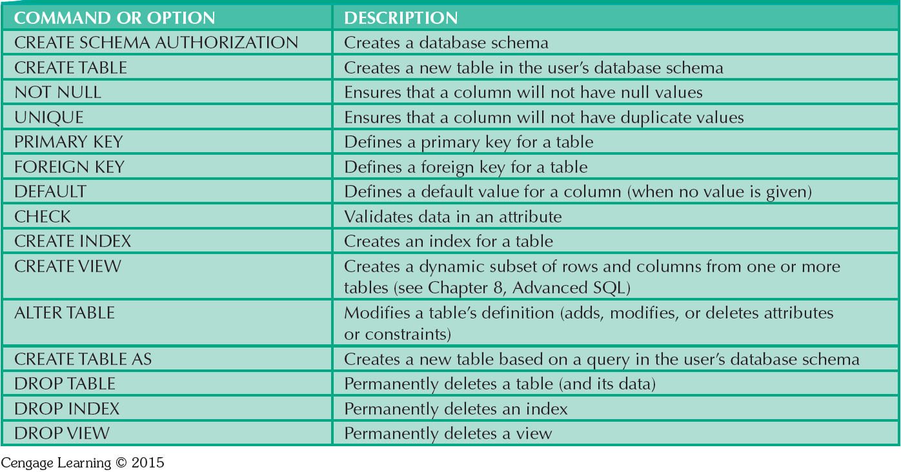
Table 7.1 - SQL Data Definition Command

Slide 5
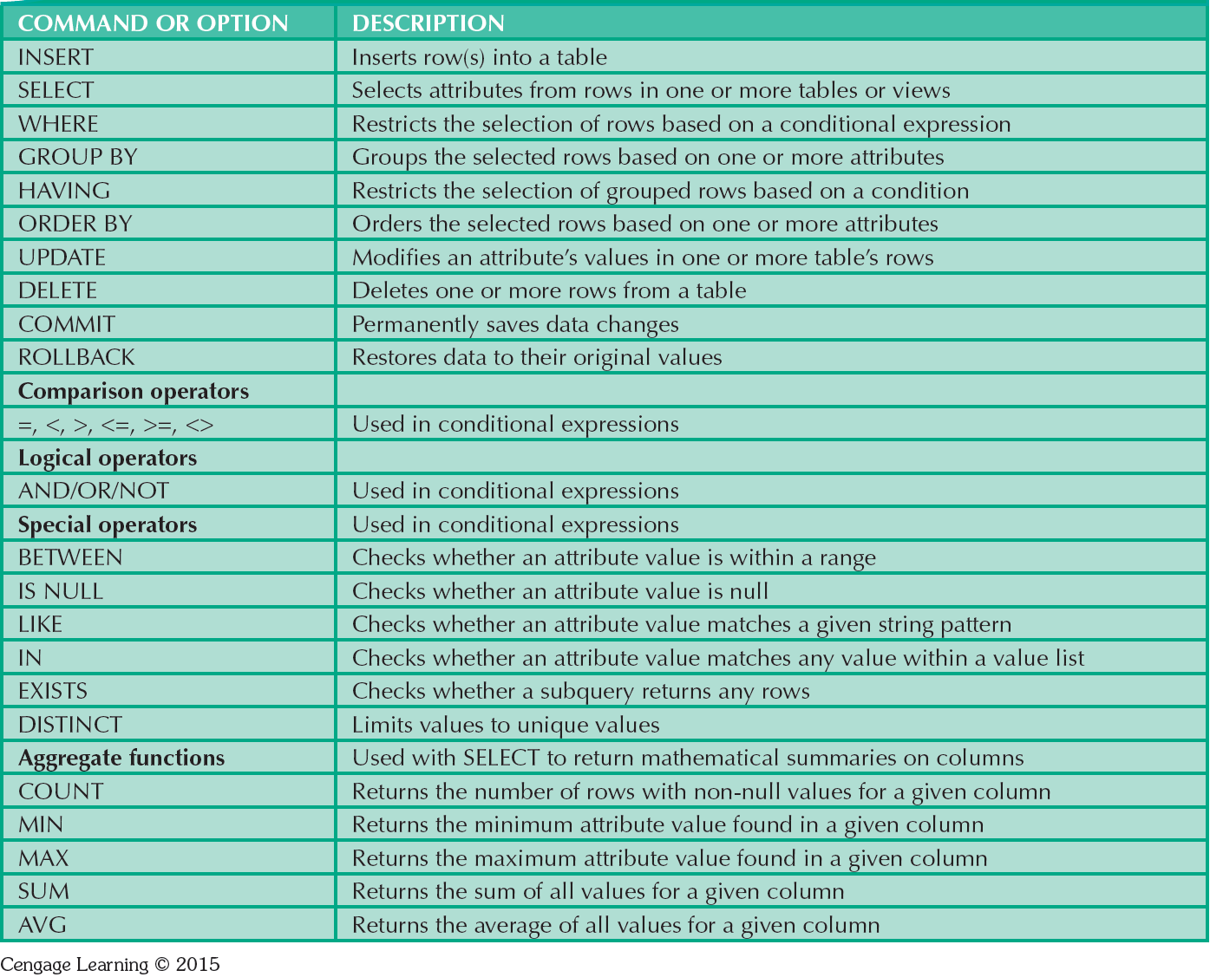
Table 7.2 - SQL Data Manipulation Commands

Slide 6
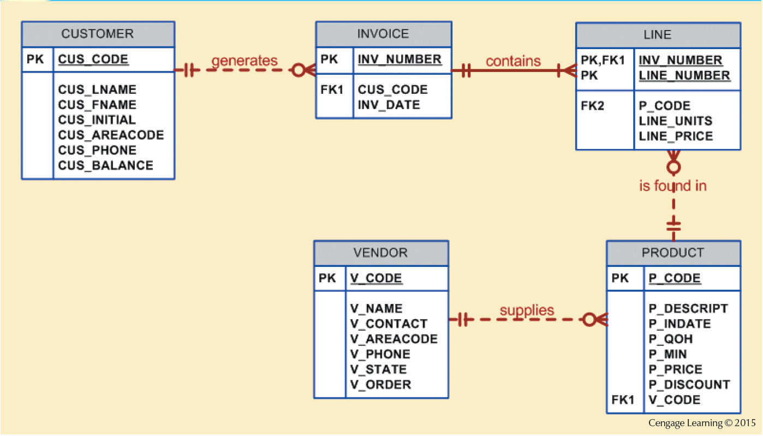
Figure 7.1 - The Database Model

Slide 7
Tasks to be Completed Before Using a New RDBMS
Create database structure
  RDBMS creates physical files that will hold database
  Differs from one RDBMS to another
Authentication: Process DBMS uses to verify that only registered users access the data
  Required for the creation tables
  User should log on to RDBMS using user ID and password created by database administrator

Slide 8
The Database Schema
Logical group of database objects related to each other
Command
  CREATE SCHEMA AUTHORIZATION {creator};
    Seldom used directly

Slide 9
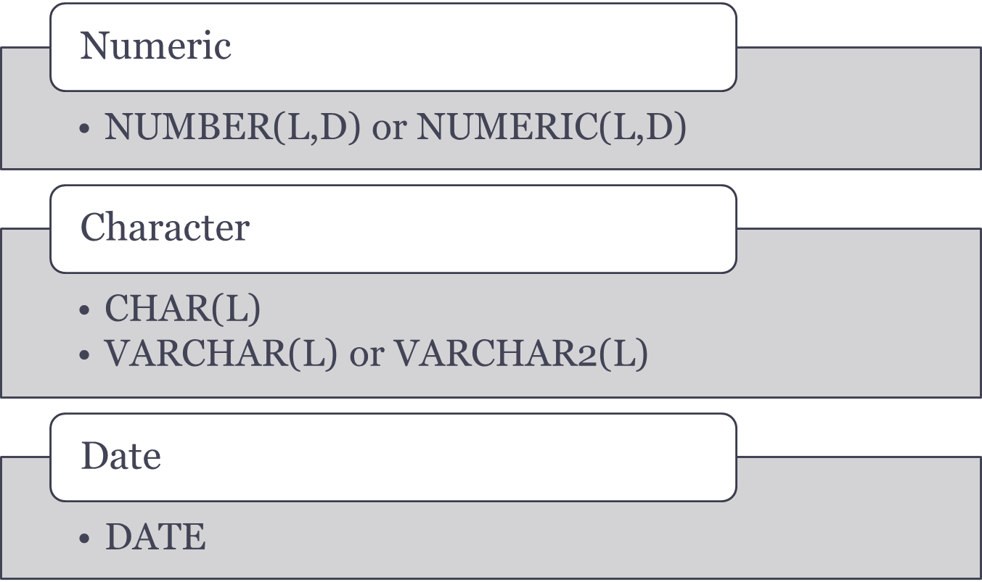
Common SQL Data Types

Slide 10
Creating Table Structures
Use one line per column (attribute) definition
Use spaces to line up attribute characteristics and constraints
Table and attribute names are capitalized
Features of table creating command sequence
  NOT NULL specification
  UNIQUE specification
Syntax to create table
  CREATE TABLE tablename();

Slide 11
Primary Key and Foreign Key
Primary key attributes contain both a NOT NULL and a UNIQUE specification
RDBMS will automatically enforce referential integrity for foreign keys
Command sequence ends with semicolon
ANSI SQL allows use of following clauses to cover CASCADE, SET NULL, or SET DEFAULT
  ON DELETE and ON UPDATE

Slide 12
SQL Constraints
NOT NULL
  Ensures that column does not accept nulls
UNIQUE
  Ensures that all values in column are unique
DEFAULT
  Assigns value to attribute when a new row is added to table
CHECK
  Validates data when attribute value is entered

Slide 13
SQL Indexes
When primary key is declared, DBMS automatically creates unique index
Composite index:
  Is based on two or more attributes
  Prevents data duplication
Syntax to create SQL indexes
  CREATE INDEX indexname ON tablename();
Syntax to delete an index
  DROP INDEX indexname;

Slide 14
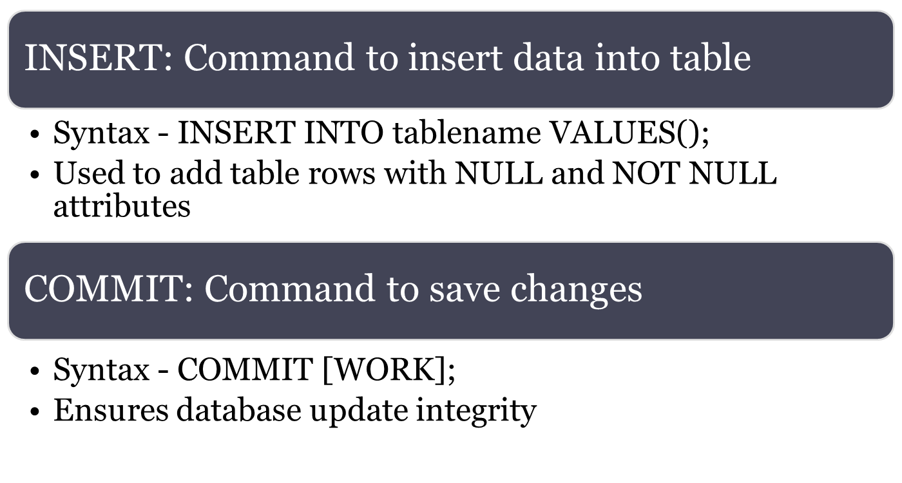
Data Manipulation Commands

Slide 15
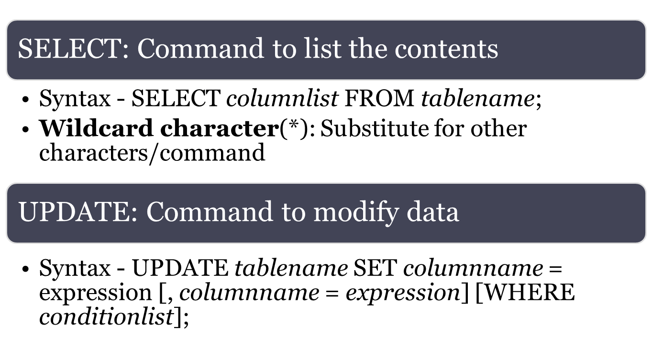
Data Manipulation Commands

Slide 16
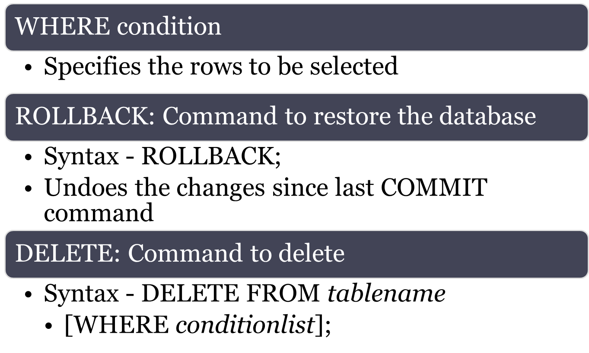
Data Manipulation Commands

Slide 17
Inserting Table Rows with a
SELECT Subquery
Syntax
  INSERT INTO tablename SELECT columnlist FROM tablename
Used to add multiple rows using another table as source
SELECT command - Acts as a subquery and is executed first
  Subquery: Query embedded/nested inside another query

Slide 18
Selecting Rows Using Conditional Restrictions
Following syntax enables to specify which rows to select
  SELECT columnlist
  FROM tablelist
  [WHERE conditionlist];
Used to select partial table contents by placing restrictions on the rows
Optional WHERE clause
  Adds conditional restrictions to the SELECT statement

Slide 19
Comparison Operators
Add conditional restrictions on selected table contents
Used on:
  Character attributes
  Dates

Slide 20
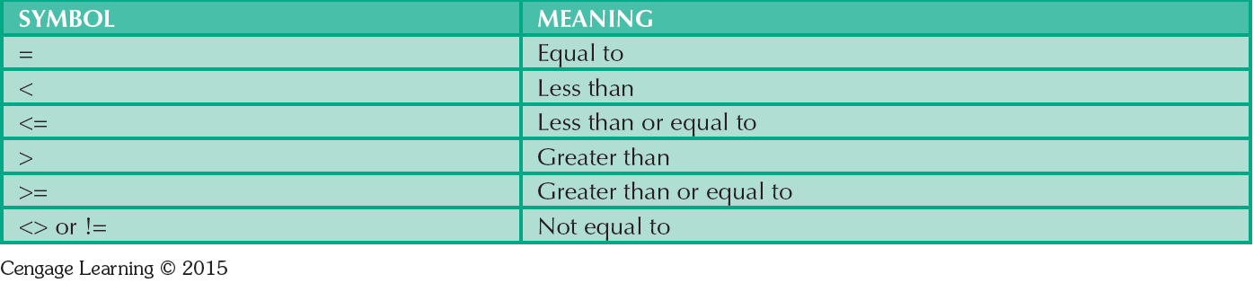
Table 7.6 - Comparison Operators

Slide 21
Comparison Operators: Computed Columns and Column Aliases
SQL accepts any valid expressions/formulas in the computed columns
Alias: Alternate name given to a column or table in any SQL statement to improve the readability
Computed column, an alias, and date arithmetic can be used in a single query

Slide 22
Arithmetic operators
The Rule of Precedence: Establish the order in which computations are completed
Perform:
  Operations within parentheses
  Power operations
  Multiplications and divisions
  Additions and subtractions

Slide 23
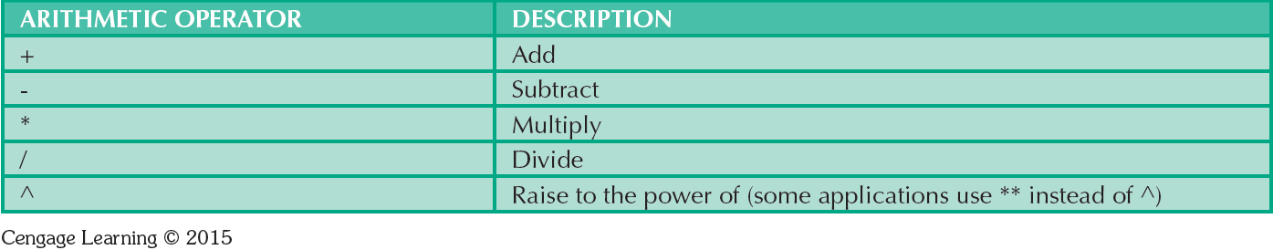
Table 7.7 - The Arithmetic Operators

Slide 24
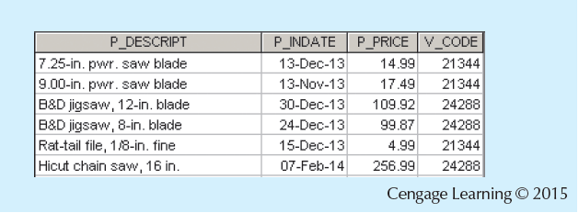
Figure 7.12 - Selected PRODUCT Table Attributes: The logical OR

Slide 25
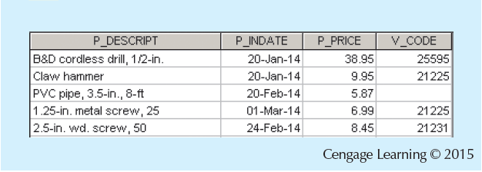
Figure 7.13 - Selected PRODUCT Table Attributes: The Logical AND

Slide 26
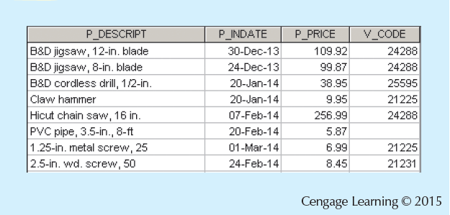
Figure 7.14 - Selected PRODUCT Table Attributes: The Logical AND and OR

Slide 27
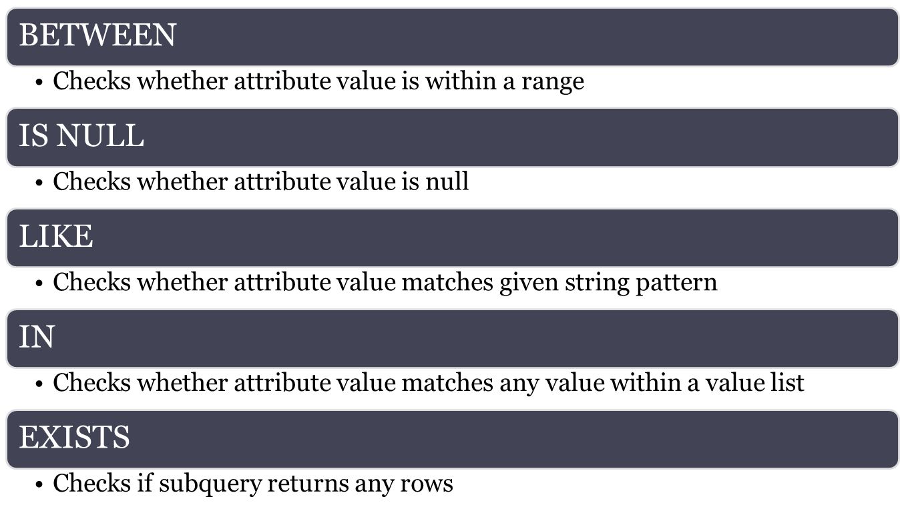
Special Operators

Slide 28
Advanced Data Definition Commands
ALTER TABLE command: To make changes in the table structure
Keywords use with the command
  ADD - Adds a column
  MODIFY - Changes column characteristics
  DROP - Deletes a column
Used to:
  Add table constraints
  Remove table constraints

Slide 29
Changing Column’s Data Type
ALTER can be used to change data type
Some RDBMSs do not permit changes to data types unless column is empty
Syntax –
  ALTER TABLE tablename MODIFY (columnname(datatype));

Slide 30
Changing Column’s Data Characteristics
Use ALTER to change data characteristics
Changes in column’s characteristics are permitted if changes do not alter the existing data type
Syntax
  ALTER TABLE tablename MODIFY (columnname(characterstic));

Slide 31
Adding Column, Dropping Column
Adding a column
  Use ALTER and ADD
  Do not include the NOT NULL clause for new column
Dropping a column
  Use ALTER and DROP
  Some RDBMSs impose restrictions on the deletion of an attribute

Slide 32
Advanced Data Updates
UPDATE command updates only data in existing rows
If a relationship is established between entries and existing columns, the relationship can assign values to appropriate slots
Arithmetic operators are useful in data updates
In Oracle, ROLLBACK command undoes changes made by last two UPDATE statements

Slide 33
Copying Parts of Tables
SQL permits copying contents of selected table columns
  Data need not be reentered manually into newly created table(s)
Table structure is created
Rows are added to new table using rows from another table

Slide 34
Adding Primary and Foreign Key Designations
ALTER TABLE command
  Followed by a keyword that produces the specific change one wants to make
  Options include ADD, MODIFY, and DROP
Syntax to add or modify columns
  ALTER TABLE tablename
    {ADD | MODIFY} ( columnname datatype [ {ADD | MODIFY} columnname datatype] ) ;
  ALTER TABLE tablename
    ADD constraint [ ADD constraint ] ;

Slide 35
Deleting a Table from the Database
  DROP TABLE: Deletes table from database
  Syntax - DROP TABLE tablename;
Can drop a table only if it is not the one side of any relationship
  RDBMS generates a foreign key integrity violation error message if the table is dropped

Slide 36
Additional SELECT Query Keywords
Logical operators work well in the query environment
SQL provides useful functions that:
  Counts
  Find minimum and maximum values
  Calculate averages
SQL allows user to limit queries to entries:
  Having no duplicates
  Whose duplicates may be grouped

Slide 37
Ordering a Listing
ORDER BY clause is useful when listing order is important
Syntax - SELECT columnlist
FROM tablelist
[WHERE conditionlist]
[ORDER BY columnlist [ASC | DESC]];
Cascading order sequence: Multilevel ordered sequence
  Created by listing several attributes after the ORDER BY clause

Slide 38
Listing Unique Values
DISTINCT clause: Produces list of values that are unique
Syntax - SELECT DISTINCT columnlist
  FROM tablelist;
Access places nulls at the top of the list
  Oracle places it at the bottom
  Placement of nulls does not affect list contents

Slide 39
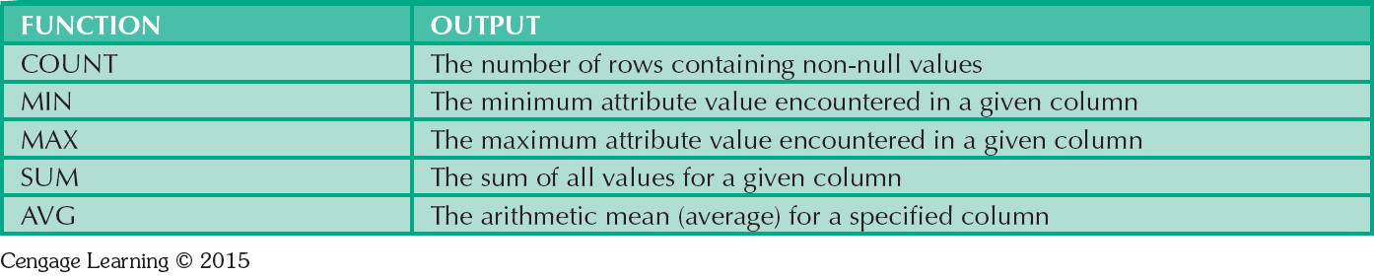
Table 7.8 - Some Basic SQL Aggerate Functions

Slide 40
Grouping Data
Frequency distributions created by GROUP BY clause within SELECT statement
Syntax - SELECT columnlist
  FROM tablelist
  [WHERE conditionlist]
  [GROUP BY columnlist]
  [HAVING conditionlist]
  [ORDER BY columnlist [ASC | DESC]];

Slide 41
HAVING Clause
Extension of GROUP BY feature
Applied to output of GROUP BY operation
Used in conjunction with GROUP BY clause in second SQL command set
Similar to WHERE clause in SELECT statement

Slide 42
Joining Database Tables
Performed when data are retrieved from more than one table at a time
  Equality comparison between foreign key and primary key of related tables
Tables are joined by listing tables in FROM clause of SELECT statement
  DBMS creates Cartesian product of every table in the FROM clause

Slide 43
Joining Tables With an Alias
Alias identifies the source table from which data are taken
Any legal table name can be used as alias
Add alias after table name in FROM clause
  FROM tablename alias

Slide 44
Recursive Joins
Recursive query: Table is joined to itself using alias
Use aliases to differentiate the table from itself

